Slide 1
SESSION
Trainer:
Bob Cornacchioli
PowerSchool
Resources 101
Organization:
DERO Technical Services
www.derotechnical.com
bcornacchioli@gmail.com
get2bobc@gmail.com

Slide 2
Agenda/Participants will be engaged in:
Introductions
PowerSource Knowledge Base & Labs
Helpful FREE Sites
YouTube
Yahoo Group List Serv’s
Raise comfort level for new users
www.derotechnical.com for more resources

Slide 3
CEO - DERO Technical Services (2007) Evangelist/Process Lead- Level Data (2010) Marketing/ - ParkBench Software (2007)
Trainer
Director of Technology and Media Services – Shrewsbury Public Schools (16 yrs) PowerSchool Administrator ( 6 yrs)
Bob Cornacchioli

Slide 4
Who are you?
Your roles and needs
One of the major things that separate PowerSchool from it’s competitors is it’s user community.
Email challenge!

Slide 5
• Normally 2 designated district contacts • Very helpful but there is a wait! • Have something do while on hold – LASAGNA • Take Notes – ESPECIALLY on ONCE A YEAR TASKS • Try the email Option too!
PowerSchool Phone Support
There is so much more
then just the phone and not having to wait is - priceless!

Slide 6
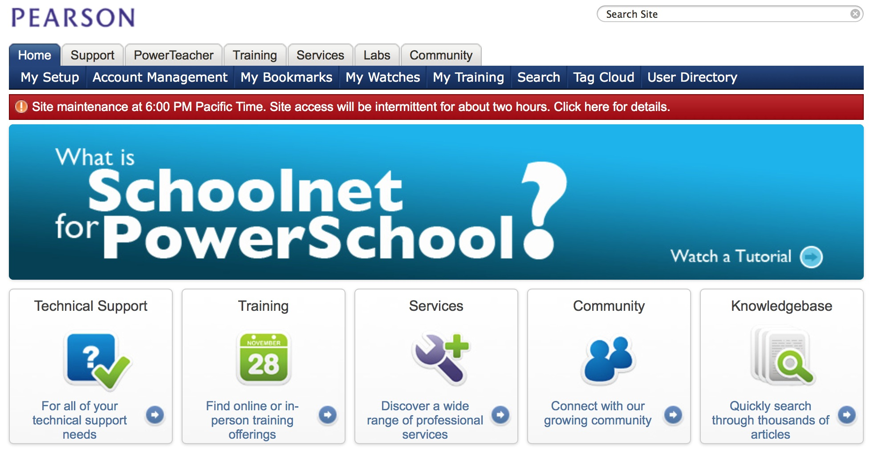
Accessing the PowerSchool Community
PowerSource by Pearson
Yahoo Groups or PSUG List Serv
Regional Monthly/Quarterly User Meetings
You Tube
Internet Resources

Slide 7
LOTS of Free Video Resources

Slide 8
GOOGLE PowerSchool Resources 1.5 Million Hits

Slide 9
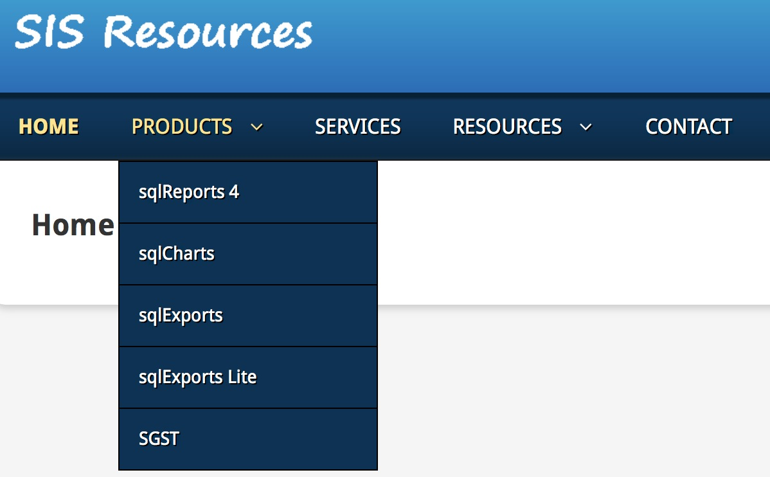
Matt Freund - http://www.sisresources.com

Slide 10
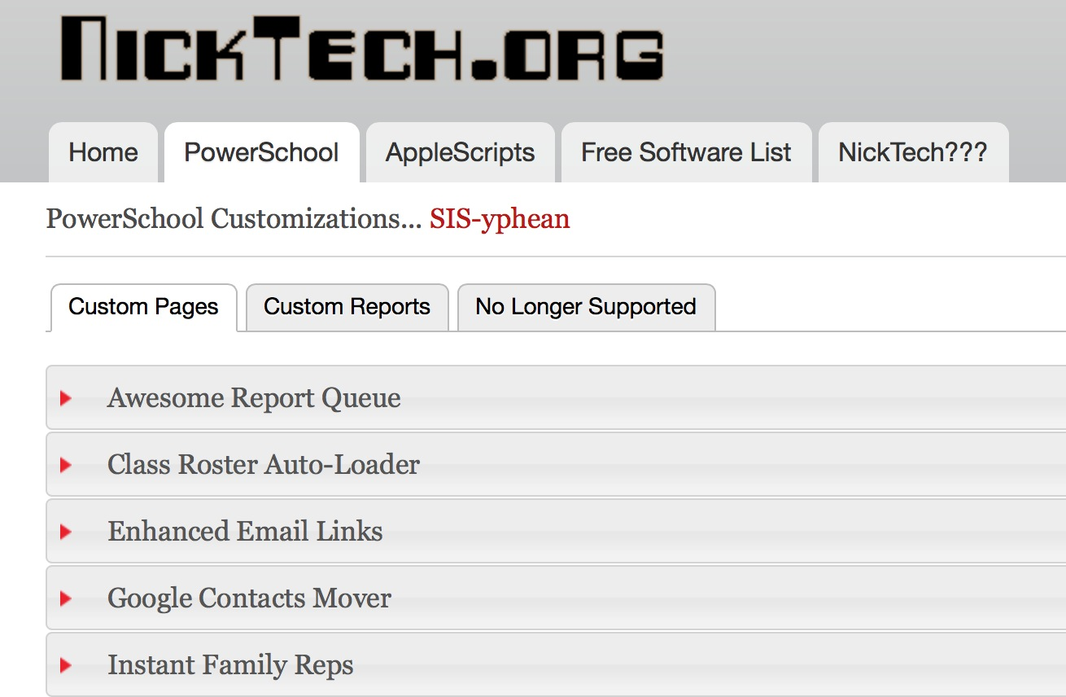
Nick Peronti – http://nicktech.org

Slide 11
http://tech.wash.k12.ut.us/PowerSchool/

Slide 12
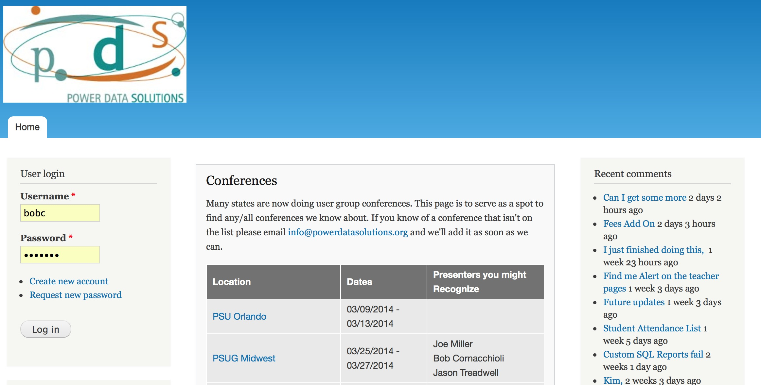
Jason Treadwell- http://www.powerdatasolutions.org
Permission Granted
Now totally FREE but you do need to create a login!

Slide 13
Bob Cornacchioli- http://www.derotechnical.com

Slide 14
http://groups.yahoo.com/
Email to psug@yahoogroups.com
Set up a rule to send all these emails into a separate inbox!

Slide 15
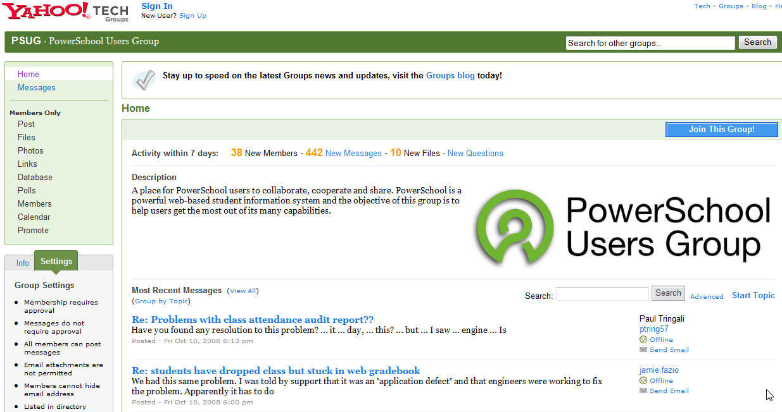
From the Group page, you can Search for answers to questions, Post questions, or go to the Files area to download reports, templates and more.

Slide 16
Better ? lead to more replies
Be as specific as you can with a complete description of your issue or request
Provide version # of PowerSchool or the Browser you were using etc.
UNLIKE this example end your ? with your name.. Your email address might not let responders know who you are.
Post questions before your deadline… the soon the better!
Informing the group that you are PANICKNG most often works against you.
If you get an answer, thank the PSUG User Community!
Your Name Here

Slide 17
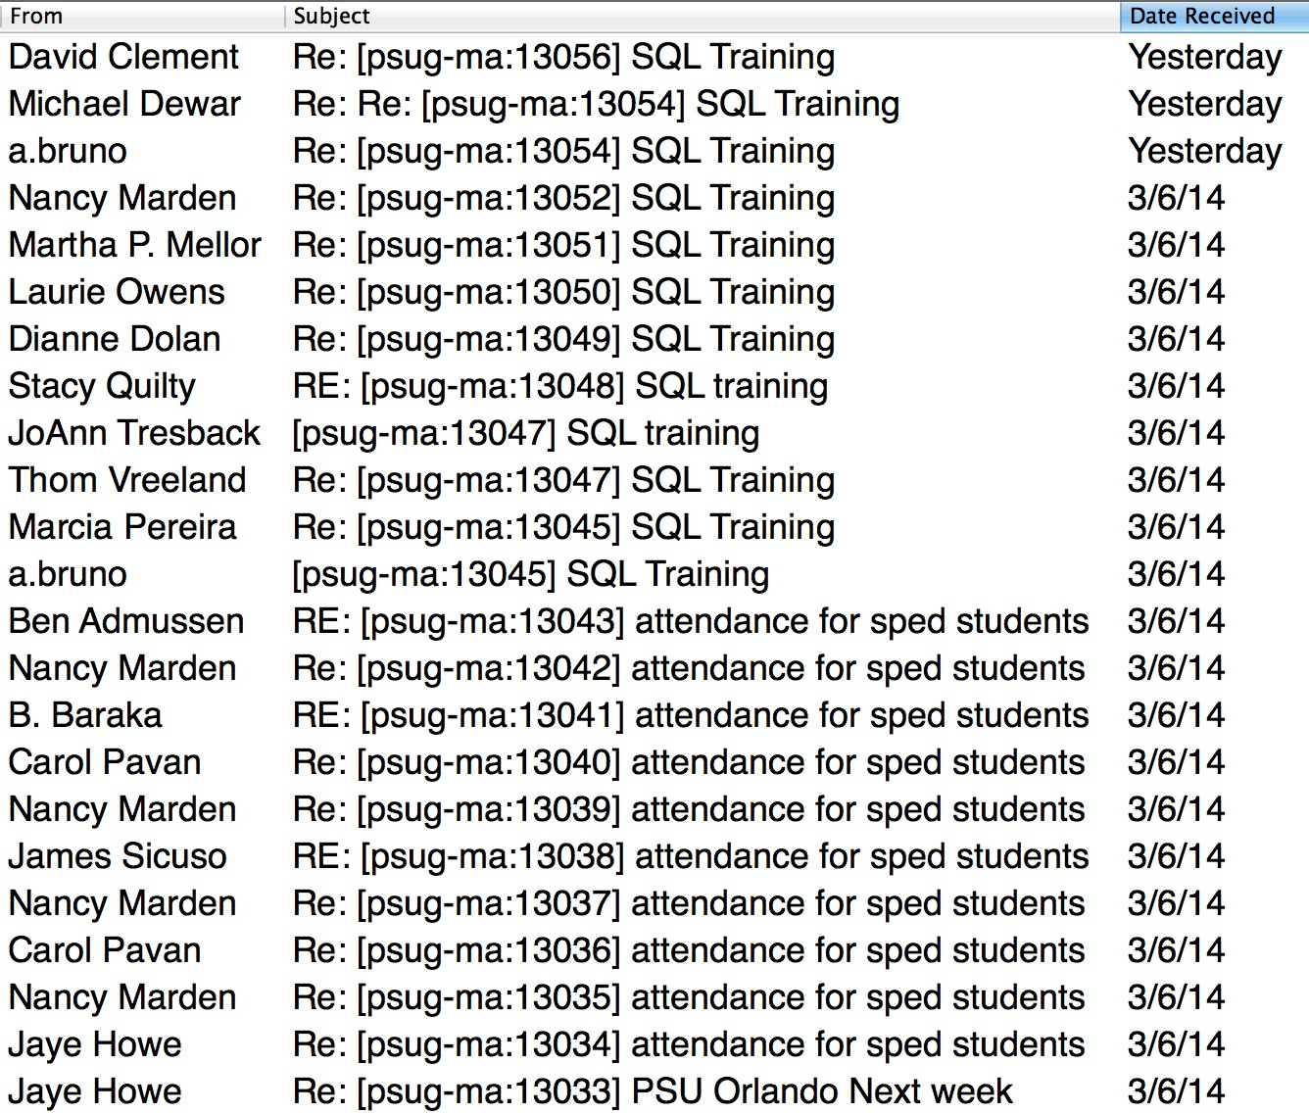
Regional/State PSUG Organizations

Slide 18
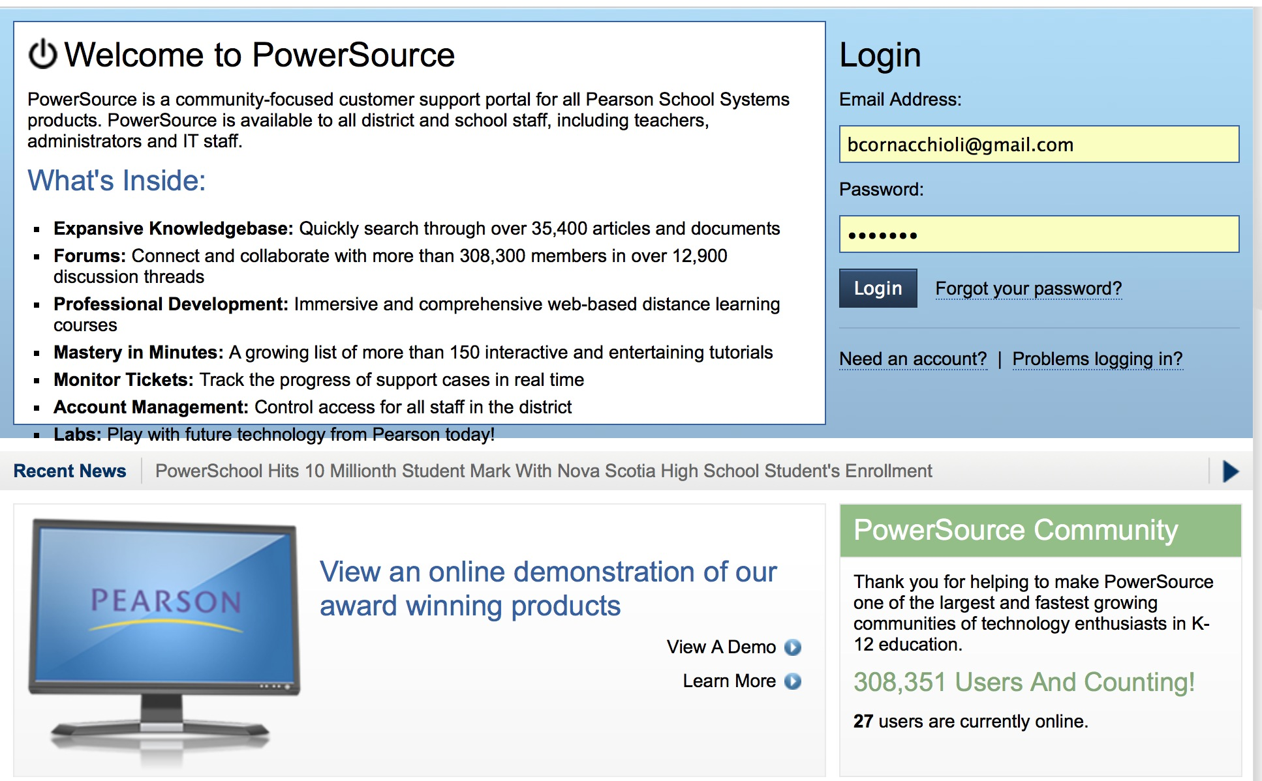
https://powersource.pearsonschoolsystems.com/login.action
https://powersource.pearsonschoolsystems.com/login.action
Your local system administrator can assist in getting you setup

Slide 19
Pearson’s PowerSource
https://powersource.pearsonschoolsystems.com/home/main.action
Wisconsin Community on PowerSource.
WI PSUG Group - meets quarterly contact Sherri Flint if you are interested.
Sflint@mba-link.com
800.258.0190 x804

Slide 20
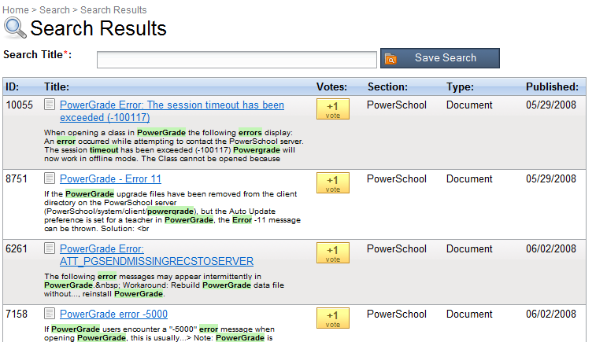
Search for a Topic
For example:
Returns the following:

Slide 21
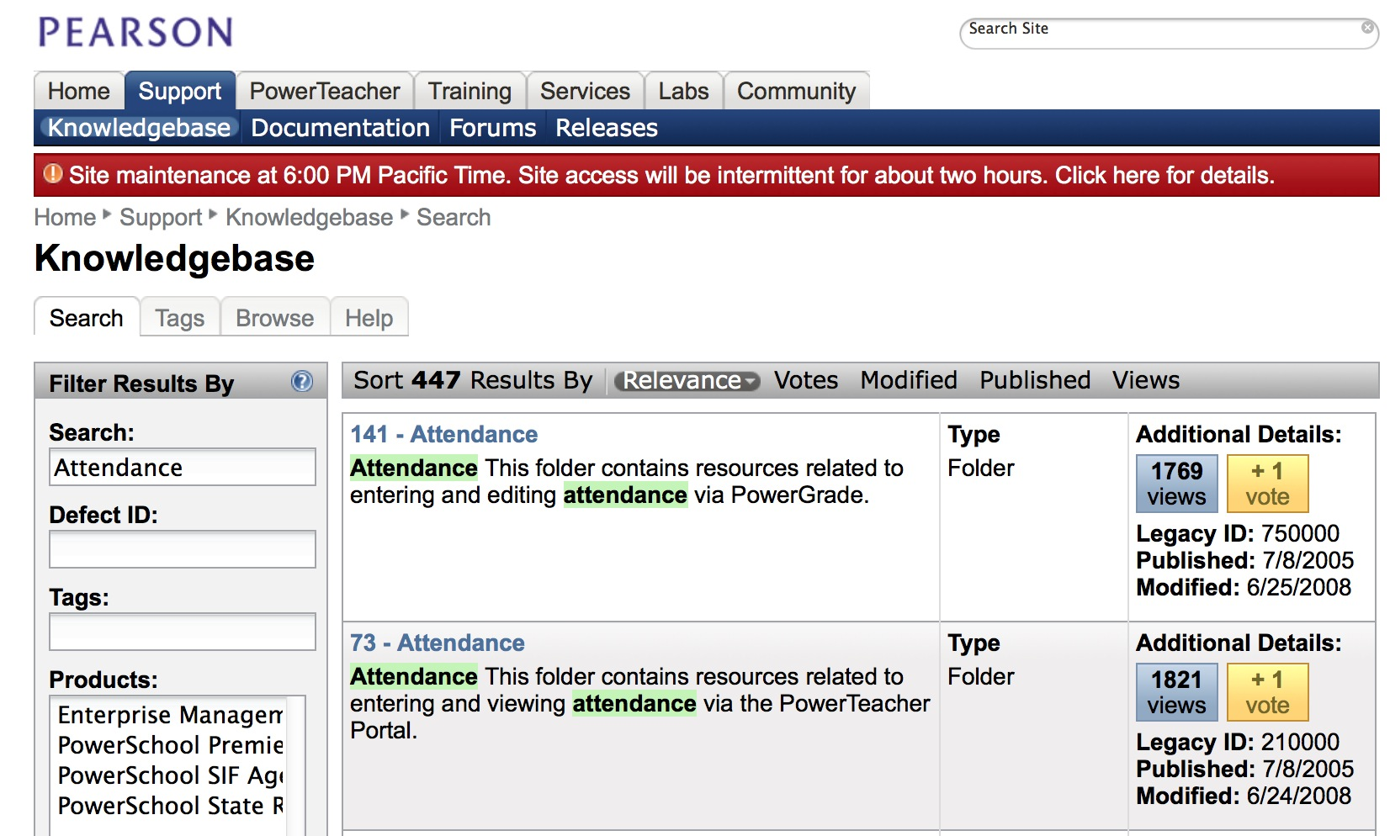

Slide 22
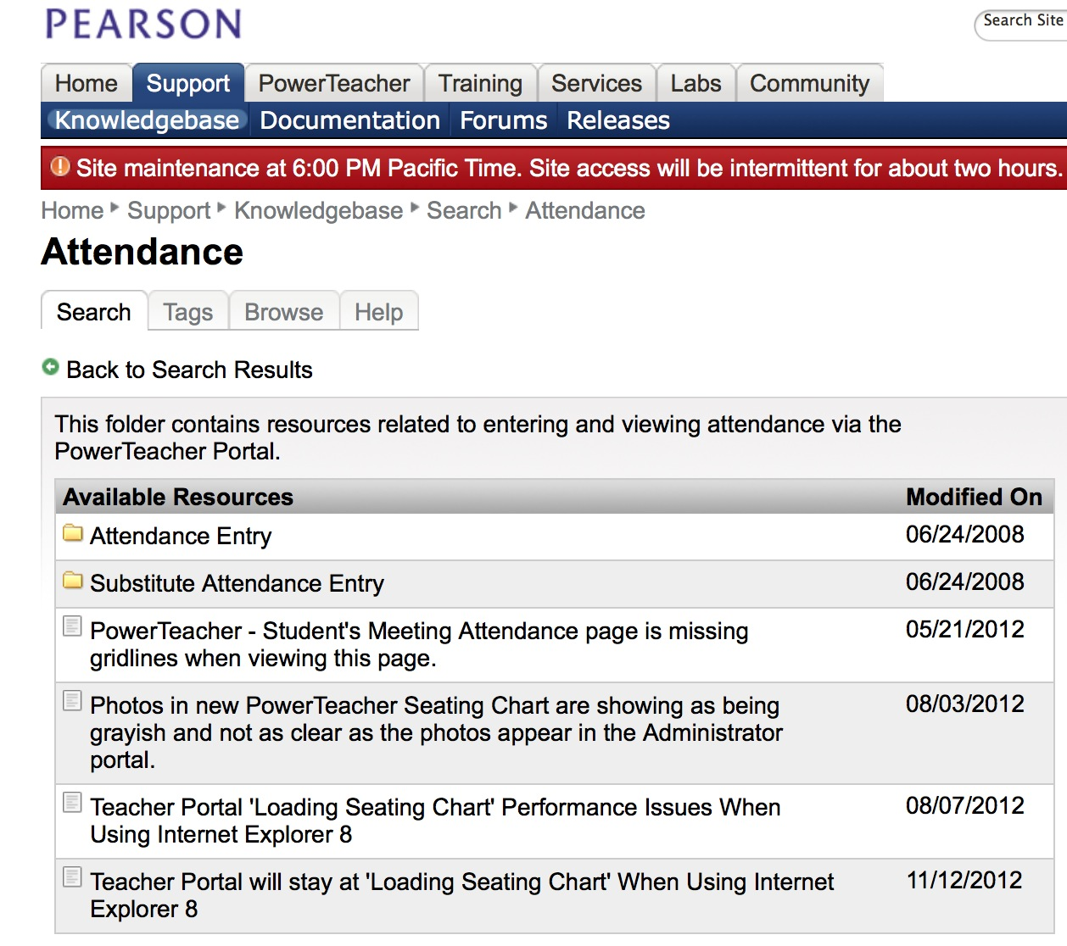

Slide 23
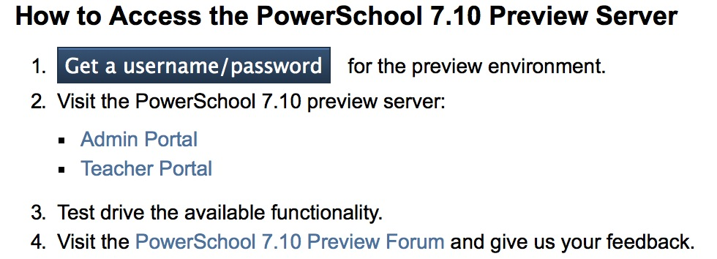
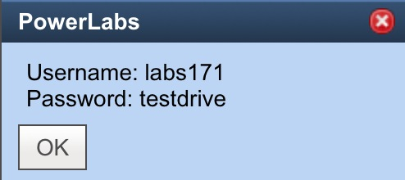
Update to the Newest Version
of PowerSchool: Use the Labs Tab

Slide 24
GET TO KNOW YOUR PS REP!!!
They can help with escalating a ticket once you have a Support Case #
Pearson reps have four main reasons for assisting with support escalations:
Performance Issues
Backup Issues
Issues that impact Funding
The case is not getting the attention it needs or you have waited and not heard back from support
KNOW YOUR REP’s NAME and eMail Address

Slide 25
Attendee’s
Start your Comparisons!
https://powersource.pearsonschoolsystems.com/psu/home/video.action
Cost
Curriculum
Overall Experience
PSUG-SW > Jan 12-14th
PSUG-NJ> April 20-22nd
PSUG-SE> May 5th-7th
PSUG-VEGAS> July 27th-30th
PSUG-MW> Mar 30 – Apr 2nd

Slide 26
I CAN DO THIS
REPEAT AFTER ME
Learn to stay connected>>>
THE KEY IS YOU!!

Slide 27
Q & A
Bob Cornacchioli DERO Technical Services
bcornacchioli@gmail.com
get2bobc@gmail.com
www.derotechnical.com
ANY AND ALL DERO RESOURCES ARE AVAILABLE
TO DOWNLOAD, TWEAK and USE FOR YOUR DISTRICT!

